Slide 1

DEPARTMENT OF ELECTRONICS AND COMMUNICATION ENGINEERING
BUILDING A SMARTER AI POWERED SPAM CLASSIFIER
TEAM MEMBERS:
R.YUVASHREE (113321106120)
L.SUSMITHA (113321106102)
S.SWATHI (113321106103)
E.SHALINI (113321106089)
B.V.NITHYASRI (113321106064)

Slide 2
PROBLEM STATEMENT
The majority of people in today’s society own a mobile phone, and they all frequently get communications (SMS/email) on their phones. But the key point is that some of the messages you get may be spam, with very few being genuine or important interactions. You may be tricked into providing your personal information, such as your password, account number, or Social Security number, by scammers that send out phone text messages. They may be able to access your bank, email, and other accounts if they obtain this information. To filter out these messages, a spam filtering system is used that marks a message spam on the basis of its contents or sender.
Develop an AI-powered spam classifier using natural language processing (NLP) and machine learning techniques to accurately distinguish between spam and non-spam messages in emails or text messages.
The goal is to reduce the number of false positives (classifying legitimate messages as spam) and false negatives (missing actual spam messages) while achieving a high level of accuracy for sending messages.

Slide 3
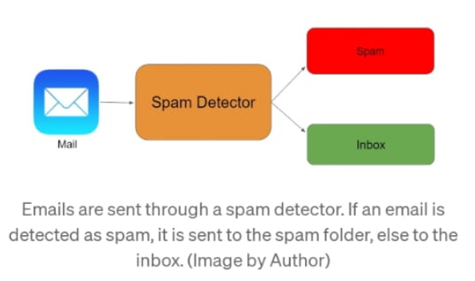
OBJECTIVES:
The main objective to use a AI based spam classifier is to detect the unsolicited and unwanted emails,we can prevent spam messages from creeping into the user’s inbox,therby improving user experience.
Building a sms spam classification model:
Split the data into train and test sets
Use Sklearn built-in classifiers to build the models
Train the data on the model
Make predictions on new data

Slide 4
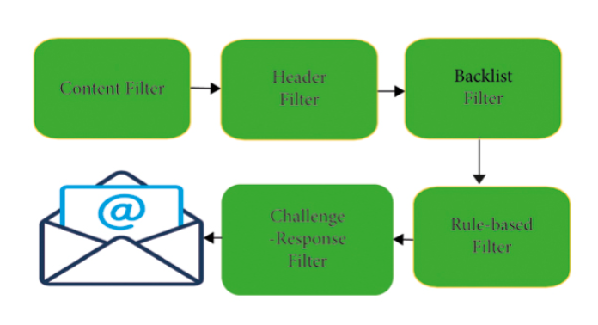
Spam Messages
The email spam definition is ambiguous since everybody has their views on it. At present, email spam is getting the attention of everyone. Email spam ordinarily includes particular spontaneous messages sent in mass by individuals you do not know. In the era of technology, the spammer shows a story where the unfortunate casualty needs forthright financial help so that the fraudster can gain a lot bigger total of cash, which they would then share. The fraudster will either earn a profit or avoid communication when the unfortunate victim completes the installment.
1.Spam Filtering Methods in Email and IoT Platforms:
The number of spam emails is rapidly increasing in marketing, chain communications, stock market tips, politics, and education . Currently, various companies develop different techniques and algorithms for efficient spam detection and filtering. We address some filtering strategies.
Method 1:The Standard Spam Filtering Method

Slide 5
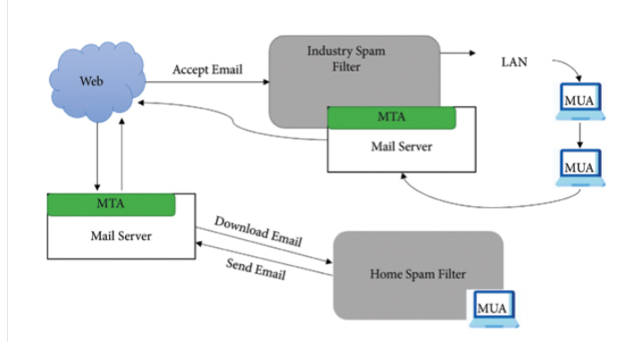
Method 2:The Client Side Spam Filtering
A client is a person who can use the Internet or email network to send or receive an email. For transmission of data, a client should deploy multiple existing frameworks on his/her system. Such systems connect with client mail agents and filter the client’s mailbox by compositing, accepting, and managing the incoming emails.
Method 3: Enterprise Level Spam Filtering
Email spam detection at the enterprise level is a technique in which various filtering frameworks are installed on the server, dealing with the mail transfer agent and classifying the collected emails into one spam or ham . This system client uses the system consistently and effectively on a network with an enterprise filtering technique to filter the emails.

Slide 6
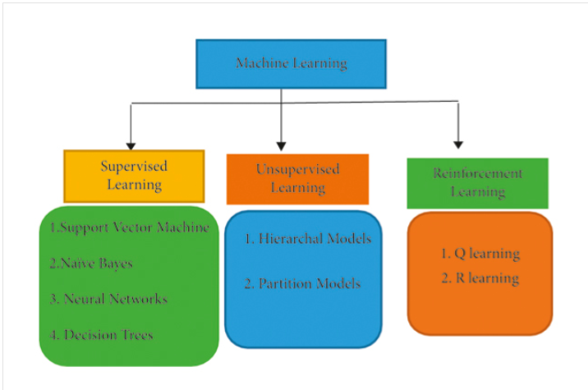
Machine Learning-Based Spam Filtering Methods:
ALGORITHM USED:
1.Naïve Bayes Classifier (NB):
The Naïve Bayes classifier is based on the Bayes theorem. It assumes that the predictors are independent, which means that knowing the value of one attribute impacts any other attribute’s value. Naïve Bayes classifiers are easy to build because they do not require any iterative process and they perform very efficiently on large datasets with a handsome level of accuracy. This research uses three steps for the filtration of emails, i.e., preprocessing, feature selection, and, at last, it implements the features by using the Naïve Bayes classifier. The preprocessing step removes all conjunction words, articles, and stop words from the email body. Then, they used the WEKA tool and made two datasets called spam data and spam base dataset.

Slide 7
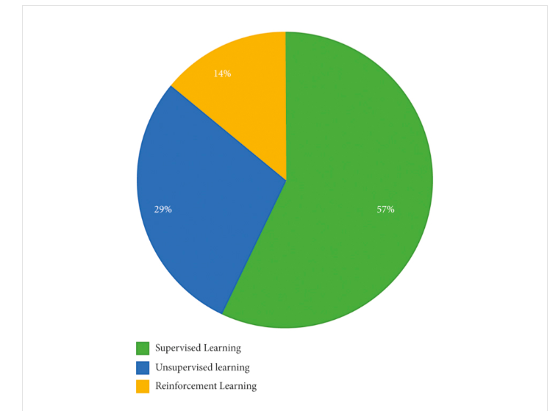
Overall Insights of the Machine Learning Algorithms for Spam Detection
The most of the datasets used to train, test, and implement different models are synthetically created. The three learning algorithms, logistic regression, Naïve Bayes, and support vector machine (SVM), are widely used.
Challenges of Spam Detection:
(i)The growing amount of data on the Internet with various new features is a big challenge for spam detection systems.
(ii)Features’ evaluation from several dimensions such as temporal, writing styles, semantic, and statistical ones is also challenging for spam filters.
(iii)Most of the models are trained on balanced datasets, while self-learning models are not possible

Slide 8
(iv)Many spam detection models face adversarial machine learning attacks that will decrease their effectiveness. Adversaries can throw a variety of attacks during the training and testing of ML models.
(v)Deep fake is another big challenge that is being faced by spam detection systems. To generate, modify, and style pictures and videos, neural network models such as GPT-2,3 and image generation models like BigGAN, StyleGAN, and CycleGAN are adopted. Deep fakes can be used to disseminate false information.
Conclusion:
Spam detection and filtration gained the attention of a sizeable research community.
The study compares these approaches and provides a summary of learned lessons from each category. This study concludes that most of the proposed email and IoT spam detection methods are based on supervised machine learning techniques. A labeled dataset for the supervised model training is a crucial and time-consuming task.
Supervised learning algorithms SVM and Naïve Bayes outperform other models in spam detection. The study provides comprehensive insights of these algorithms and some future research directions for email spam detection and filtering.

Slide 9
THANK YOU

